Slide 1
Binary Classification of Long COVID Using Health-Related Survey Data
By Tom Lupicki, Kenan Rustamov, and Akshat Chauhan

Slide 2
Importance
19% of US adults with COVID report having Long COVID
Worldwide estimated to be 400 million
No single test available that people can take to determine Long COVID
Long COVID is determined by doctor based on prior health data and current symptoms
A cheap and fast ML predictor could be used as pre screening for high risk individuals
A high risk for pre screening could receive further specialized care by doctors

Slide 3
Problem Overview
Goal
Predict the presence of Long COVID (yes/no) from health survey data
Data Source
2023 BRFSS (Behavioral Risk Factor Surveillance System) data.
Outcome Variable
“Do you currently have long-term symptoms post-COVID infection?” (Binary: Yes/No)

Slide 4
Data (Introduction)
Center for Disease Control (CDC) Behavioural Risk Factor Surveillance System (BRFSS) Survey Data
Health related telephone survey that collect information on risk behaviors, chronic health conditions, and use of preventative services
Collected throughout the United States every year
Readily available for many ML predictions
Kentucky and Pennsylvania not included due to low data collection
Questions such as health status, health-care access, alcohol consumption, tobacco use
Deal almost exclusively with Core component as optional modules and state added questions are specific to certain states (all other states will no have them)
433,000 rows of data
Data Types: Numerical and Categorical
Notes:
https://www.cdc.gov/brfss/about/brfss_faq.htm

Slide 5
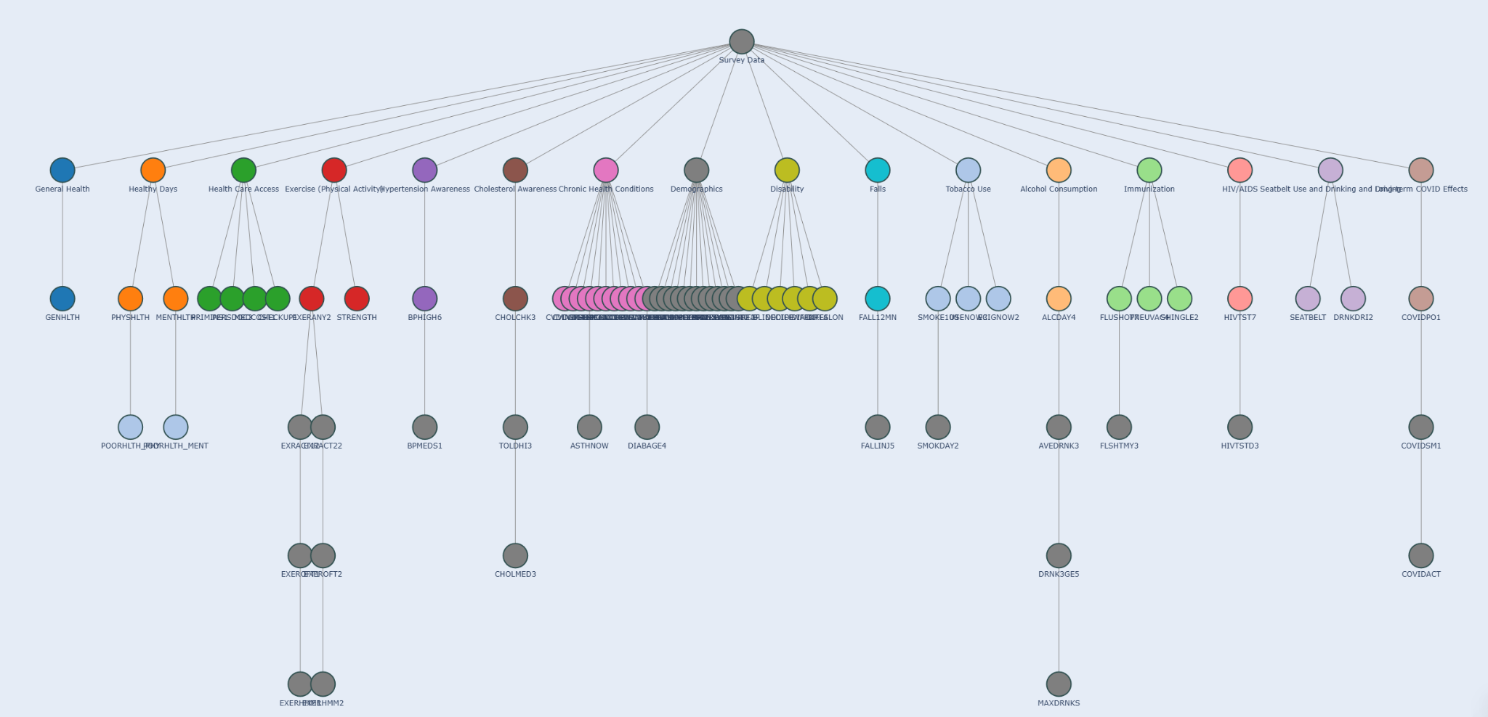
Data (Challenges)
Raw Survey
Issues due to lack of data cleaning or imputation
Missing Data
Incomplete data - some people just hang up the phone
our target variable was one of the last questions
Questions have dependencies
“Don’t Know” / “Refused” vs BLANK
Lots of Features
74 Core features
Mix of Data types
Answers for sex at birth vs height
Class Imbalance
85% no, 15% yes

Slide 6
Preprocessing (Categorical)
Based on available information, we believe data might be MNAR
Questions like Income level depend on the income of the person
However we test simpler assumptions of MAR and MCAR
Use Pandas categorical typing to mark categorical columns
Retain “Don’t know” / “Refused” as separate valid categories
For some follow-up questions not asked due to earlier answers, encode a “Missing” category (e.g., -1) to preserve potential signals from missingness patterns

Slide 7
Preprocessing (Numerical)
Data Transformation
Standardize measurement units:
For example: standardize height/weight to metric
HMM -> just minutes
Process data formatting (e.g., 0-999 might be 0-999 times per week, 1000-1999 might be 0-999 times per month)
Convert coded values (777,999) to NaN
Imputing Values
Logic Based-Imputations
Ex. If Person never exercised, “minutes spent exercising” is 0 instead of NaN
We experiment with the assumption that variables in the model are predictive of missing data in some numerical features
For instance weight, age, average height indicative of height
Imputed these values with MICE (More later)

Slide 8
Factor Analysis of Mixed Date (FAMD)
To solve our issue with features, we felt many of the features were important but did not want to face the curse of dimensionality
Traditional PCA handles only continuous data
FAMD reduces dimensionality while preserving mixed data
Apply FAMD after handling missing data values
Notes:
https://www.sciencedirect.com/science/article/abs/pii/0169743987800849
https://scikit-learn.org/1.5/modules/generated/sklearn.decomposition.PCA.html

Slide 9
Weighting data
Strong imbalance of data
Considered SMOTE
Traditional SMOTE would not work due to categorical data
SMOTE NC would not work due to the dependent nature of some of our variables on other variables i.e. they cannot just be predicted by other values for the same feature
Use native weight features to heavily weight errors in the class with less data
Notes:
https://jair.org/index.php/jair/article/view/10302

Slide 10
Multivariate Imputation by Chained Equations (MICE)
Used to impute missing values based on the values of the missing features
Start with an initial guess
Treat each feature with missing values as a regression problem
Each iteration updates the imputed values until convergence or number of cycles
In Sci-Kit Learn this is IterativeImputer
Notes:
https://scikit-learn.org/1.5/modules/generated/sklearn.impute.IterativeImputer.html#sklearn.impute.IterativeImputer
Azur MJ, Stuart EA, Frangakis C, Leaf PJ. Multiple imputation by chained equations: what is it and how does it work? Int J Methods Psychiatr Res. 2011 Mar;20(1):40-9. doi: 10.1002/mpr.329. PMID: 21499542; PMCID: PMC3074241.

Slide 11
Models
Logistic Regression
Decision Tree
Random Forest
AdaBoost
Histogram-based Gradient Boosting Classification Tree (HGBC)
Light Gradient-Boosting Machine (LightGBM)
Extreme Gradient Boosting (XGBoost)
Why
Many of the models inherently have features to handle class imbalances
Traditionally these have strong performance, and are frequently used in medical data applications
Much of the data is categorical
Wanted to compare different approaches to see best result

Slide 12
Results
Experimental Conditions
Drop Missing (Assume MCAR)
Keep Missing (NaN-Aware Models)
Impute Missing (Assume MAR)
Metrics
Accuracy, Precision, Recall, F1-score using K-Folds Cross Validation
Want high recall, low variability between runs

Slide 13
Results (Best)
Drop Missing (Assume MCAR)
HGBC without FAMD
Accuracy: 0.68
Precision: 0.24
Recall: 0.61
F1: 0.34
Keep Missing (NaN-Aware Models)
HGBC without FAMD
Accuracy: 0.68
Precision: 0.24
Recall: 0.61
F1: 0.34
Impute Missing (Assume MAR)
LightGBM with FAMD
Accuracy: 0.69
Precision: 0.23
Recall: 0.57
F1: 0.33

Slide 14
Results (Analysis)
Mixed results 70% accuracy and 60% recall, but 25% precision
FAMD either diminished results or stayed the same and reduced recall
Does not improve predictability of Long COVID
Does not improve minority class detection
The variance is spread between a large number of variables
This means that there are no few strongly variant components that we could reduce down to that would help us in prediction

Slide 15
Results (Analysis Contd.)
Dropping vs. Keeping Missing vs. Imputation
No clear gains with imputation
Assume other features are not predictive of missing data
No Clear gains with Dropping
NaN-Aware models perform the same
Random Forest gets almost 0 Recall
Decision Tree works better but still low recall
Logistic Regression, AdaBoost, HGBC, LightGBM, XGBoost have identical performance

Slide 16
Results (Lessons)
Our model is slightly predictive of Long COVID and may be used as a first step in identifying risk factors
However, it should not be used for treatment decisions due to poor performance (Precision, F-1, Accuracy, Recall)
The data itself may not be strongly predictive of Long COVID, but that is to be expected without a lot of healthcare data
Strong Class imbalance led some predictors to perform poorly
Missing Data is hard
Had to experiment with strong assumptions that, in reality, might not hold

Slide 17
Future Direction
Prediction of long covid with hand-selected healthcare features that are known risk factors - use domain knowledge from healthcare experts
Analysis on modeling the missingness of the data
Could combine dataset with future BRFSS datasets to help with class imbalance

